Slide 1
L3- SNA
Musica Supriya

Slide 2
Basic network structure and properties
Subnetworks
Cliques
Singletons, Dyad, triad
Clusters
Egocentric networks
Paths & Connectedness
Bridges and hubs

Slide 3
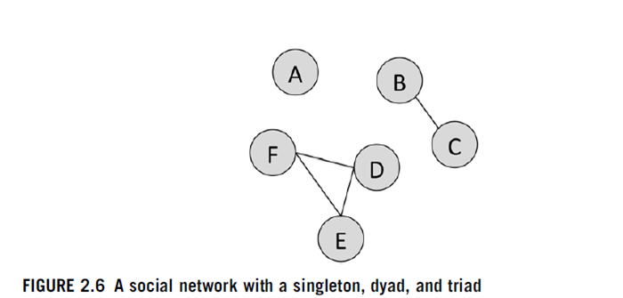

Slide 4
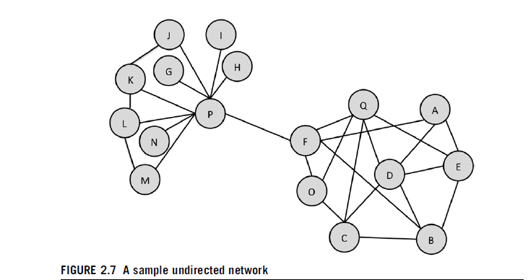

Slide 5
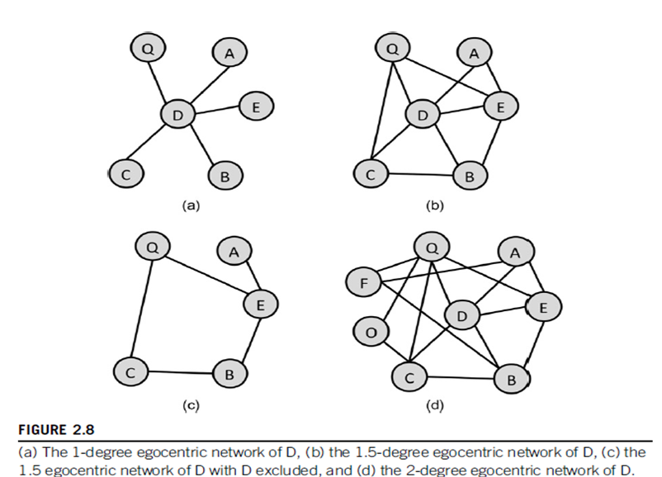

Slide 6
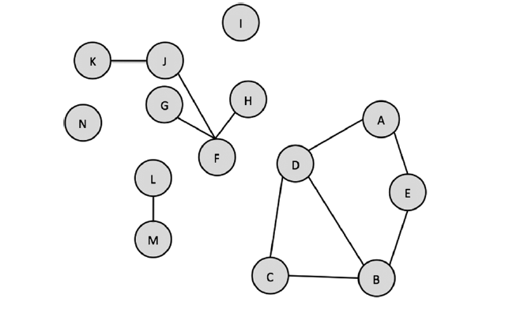
Exercise :
A)How many singletons are there in the network? List them.
B) What is the largest connected component?
C) Are there any bridges in the network? If so, where are they?
D)Create an adjacency list for the network.
E)Create an adjacency matrix for the network.

Slide 7
B
A
K
P
E
D
I
N
C
F
O
J
G
H
M
Figure 3: A Sample Network

Slide 8
Are there any hubs or bridges in the fig. 3? If yes specify.
Is there a singleton?
Do find any Clique in the network
Draw the 1,1.5, 2-degree egocentric network for the graph(Consider node “F” )
Are they strongly connected? (Y/N)

Slide 9
References:
Chapter 2, Analysis of Social Network, Jennifer Golbeck

